Slide 1
Lecture 3
Algorithm Analysis
Arne Kutzner
Hanyang University / Seoul Korea

Slide 2
Heapsort

Slide 3
Fundamentals - Heap
A Heap is a nearly complete binary tree, where each node comprises some value.
Heap-Property: the value of some node N is greater than or equal to the values of both children of N
Height of node = # of edges on a longest simple path from the node down to a leaf.
Height of heap
= height of root
= Θ(lg n), where n is the of nodes in
the tree
Algorithm Analysis
L3.<number>

Slide 4
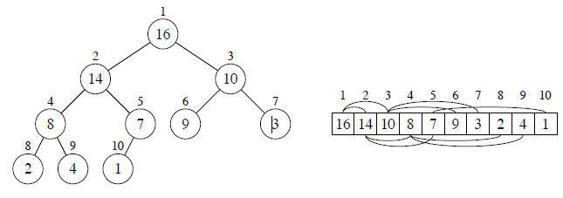
Heap as Datastructure
Interpretation of arrays as trees:
PARENT(i)
return ⌊i/2⌋
LEFT(i)
return 2i
RIGHT(i)
return 2i + 1
There are Max-heaps and min-heaps
Algorithm Analysis
L3.<number>

Slide 5
MAX-HEAPIFY
MAX-HEAPIFY is used to maintain the max-heap property.
  Before MAX-HEAPIFY, A[i] may be smaller than its children.
  Assume left and right subtrees of i are max-heaps.
  After MAX-HEAPIFY, subtree rooted at i is a max-heap.
Algorithm Analysis
L3.<number>

Slide 6
The way MAX-HEAPIFY works
Compare A[i ], A[LEFT(i )], and A[RIGHT(i )].
If necessary, swap A[i ] with the larger of the two children to preserve heap property.
Continue this process of comparing and swapping down the heap, until subtree rooted at i is max-heap. If we hit a leaf, then the subtree rooted at the leaf is trivially a max-heap.
Algorithm Analysis
L3.<number>

Slide 7
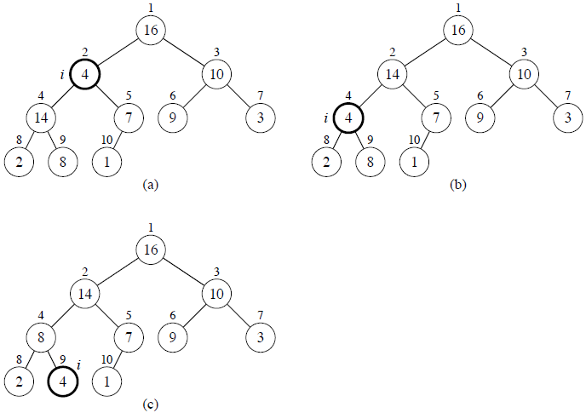
MAX-HEAPIFY example
Algorithm Analysis
L3.<number>

Slide 8
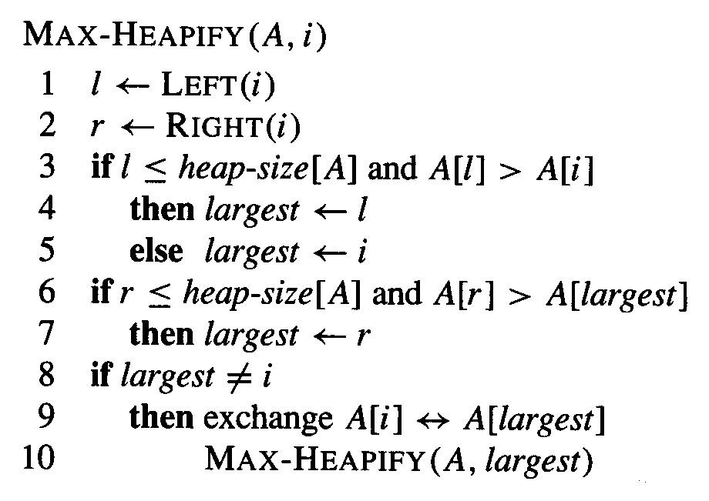
MAX-HEAPIFY Pseudocode
Time / Comparisons: O(lg n).
Algorithm Analysis
L3.<number>

Slide 9
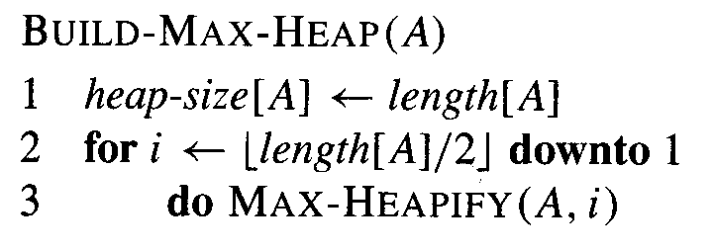
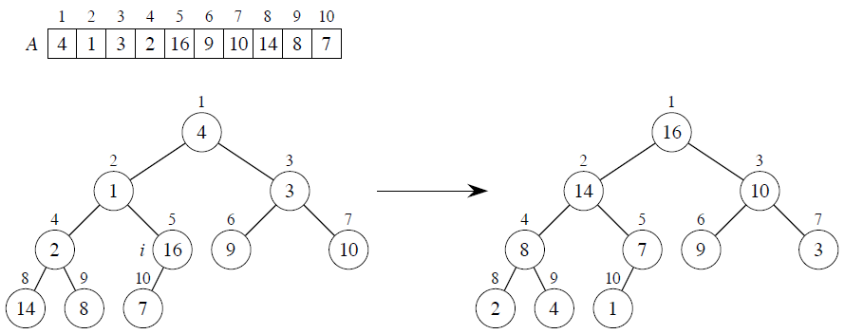
Using MAX-HEAPIFY for creating a Max-heap
Algorithm Analysis
L3.<number>
Primitive Max-heaps

Slide 10
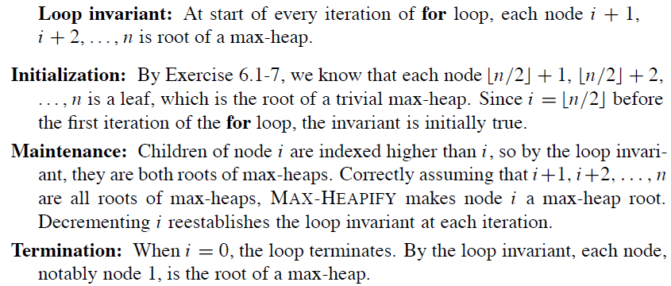
Build-Max-Heap Correctness
Algorithm Analysis
L3.<number>

Slide 11



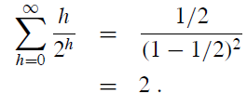
Complexity Build-Max-Heap
Obviously O(n log(n))
Tighter Analysis:
Number of nodes of height h:
Time/Comparisons:
We use Formula A.8 (Textbook)
And get:
Algorithm Analysis
L3.<number>

Slide 12
Heapsort Algorithm
Starting with the root (the maximum element), the algorithm places the maximum element into the correct place in the array by swapping it with the element in the last position in the array.
Discard. this last node (knowing that it is in its correct place) by decreasing the heap size, and calling MAX-HEAPIFY on the new (possibly incorrectly-placed) root.
Repeat this .discarding. process until only one node (the smallest element) remains, and therefore is in the correct place in the array.
Algorithm Analysis
L3.<number>

Slide 13
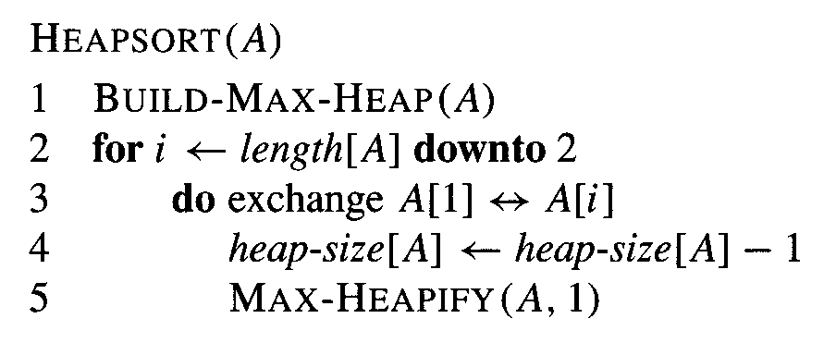
Pseudcode Heapsort algorithm
Complexity:
BUILD-MAX-HEAP: O(n)
• for loop: n − 1 times / exchange elements: O(1)
• MAX-HEAPIFY: O(lg n)
Total time: O(n lg n)
Algorithm Analysis
L3.<number>

Slide 14
Priority Queues

Slide 15
Priority queue
Maintains a dynamic set S of elements.
Each set element has a key - an associated value.
Max-priority queue supports dynamic-set operations:
  INSERT(S, x): inserts element x into set S.
  MAXIMUM(S): returns element of S with largest key.
  EXTRACT-MAX(S): removes and returns element of S with largest key.
  INCREASE-KEY(S, x, k): increases value of element x.s key to k. Assume k ≥ x.s current key value.
Algorithm Analysis
L3.<number>

Slide 16
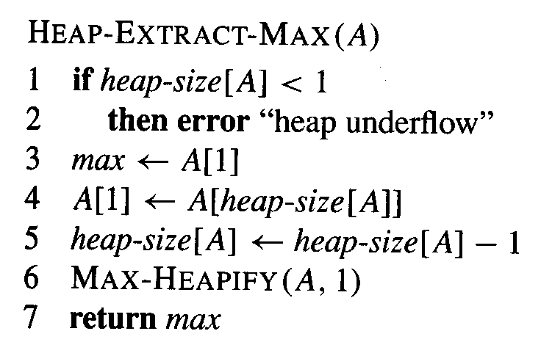
Priority queues 1
Algorithm Analysis
L3.<number>

Slide 17
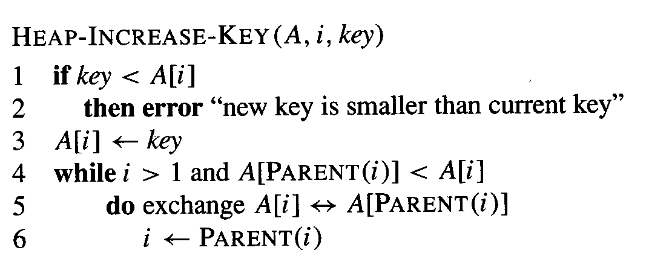
Priority queues 2
Algorithm Analysis
L3.<number>

Slide 18
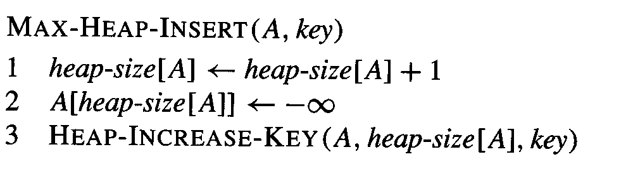
Priority queues 3
Algorithm Analysis
L3.<number>

Slide 19
Quicksort

Slide 20
Highlights
Worst-case running time: Θ(n²).
Expected running time: Θ(n lg n).
Constants hidden in Θ(n lg n) are small.
Sorts in place.
Algorithm Analysis
L3.<number>

Slide 21
Divide and Conquer Strategy with Quicksort
Divide: Partition A[p . . r ], into two (possibly empty) subarrays A[p . . q − 1] and A[q + 1 . . r ], such that each element in the first subarray A[p . . q − 1] is ≤ A[q] and A[q] is ≤ each element in the second subarray A[q + 1 . . r ]
Conquer: Sort the two subarrays by recursive calls to QUICKSORT
Combine: No work is needed to combine the subarrays, because they are sorted in place.
Algorithm Analysis
L3.<number>

Slide 22
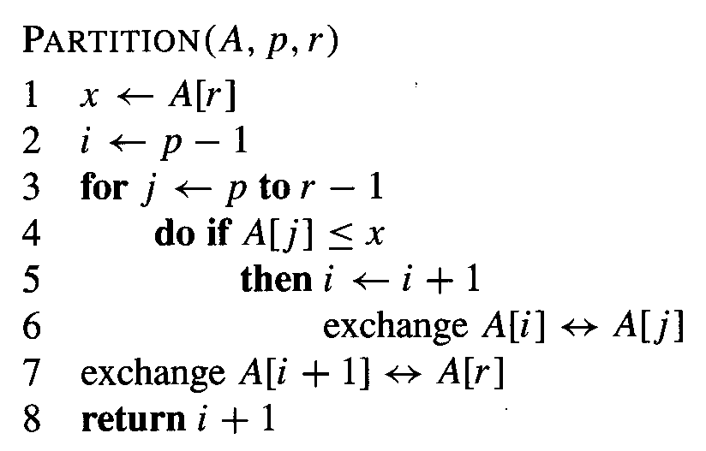
Pseudocode Partition
Algorithm Analysis
L3.<number>

Slide 23
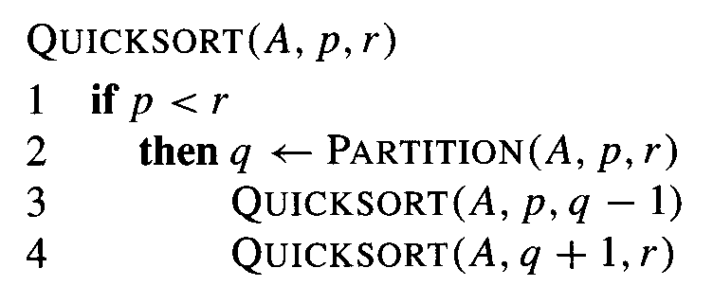
Pseudocode Algorithm
Algorithm Analysis
L3.<number>

Slide 24
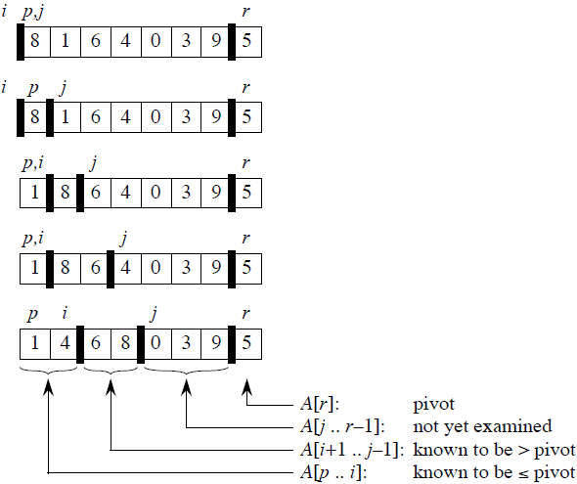
Creation of Partitions
(Divide Step)
Loop invariant:
1. All entries in A[p . . i ] are ≤ pivot.
2. All entries in A[i + 1 . . j − 1] are > pivot.
3. A[r ] = pivot.
Algorithm Analysis
L3.<number>

Slide 25
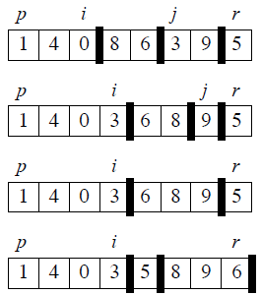
Creation of Partitions
(Divide Step)
Time for partitioning:
Θ(n) to partition an n-element subarray.
left recursive call
right recursive call
Algorithm Analysis
L3.<number>

Slide 26
Correctness of Partition
Initialization: Before the loop starts, all the conditions of the loop invariant are satisfied, because r is the pivot and the subarrays A[p . . i ] and A[i +1 . . j −1] are empty.
Maintenance: While the loop is running, if A[ j ] ≤ pivot, then A[ j ] and A[i +1] are swapped and then i and j are incremented. If A[ j ] > pivot, then increment only j .
Termination: When the loop terminates, j = r , so all elements in A are partitioned into one of the three cases: A[p . . i ] ≤ pivot, A[i + 1 . . r − 1] > pivot, and A[r ] = pivot.
Algorithm Analysis
L3.<number>

Slide 27
Worst-Case (intuitive)
Occurs when the subarrays are completely unbalanced.
Have 0 elements in one subarray and
n − 1 elements in the other subarray.
Get the recurrence
T(n) = T (n − 1) + T (0) + Θ(n)
= T (n − 1) + Θ(n)
= Θ(n²)
Algorithm Analysis
L3.<number>

Slide 28
Best Case (intuitive)
Occurs when the subarrays are completely balanced every time.
Each subarray has ≤ n/2 elements.
Get the recurrence
T(n) = 2T(n/2) + Θ(n)
= Θ(n lg n)
Algorithm Analysis
L3.<number>

Slide 29
Balanced Partitioning
Quicksort’s average running time is much closer to the best case than to the worst case.
Imagine that PARTITION always produces a 9-to-1 split.
  Get the recurrence
  T(n) ≤ T(9n/10) + T(n/10) + Θ(n)
  = O(n lg n)
Algorithm Analysis
L3.<number>

Slide 30
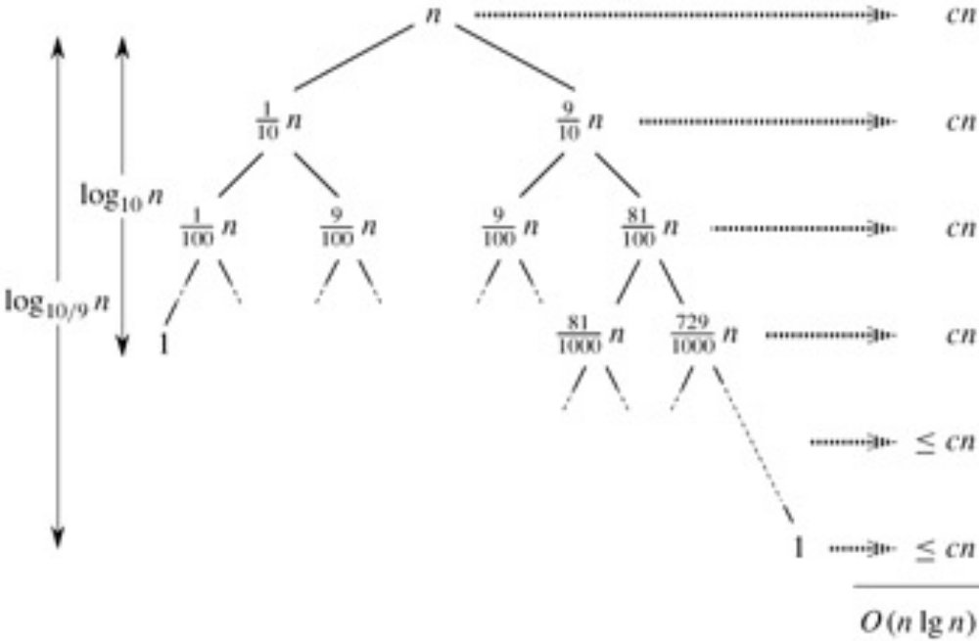
Balanced Partitioning (cont.)
full levels
longest path
Algorithm Analysis
L3.<number>

Slide 31
Average Case (Intuition)
Splits in the recursion tree will not always be constant.
There will usually be a mix of good and bad splits throughout the recursion tree.
To see that this doesn’t affect the asymptotic running time of quicksort, assume that levels alternate between best-case and worst-case splits.
Algorithm Analysis
L3.<number>

Slide 32
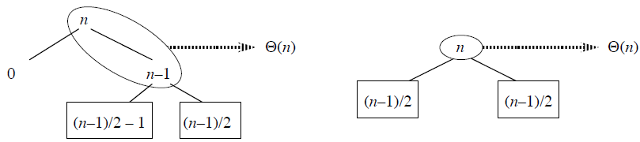
Average Case (Intuition)
The extra level in the left-hand figure only adds to the constant hidden in the notation.
There are still the same number of subarrays to sort, and only twice as much work was done to get to that point.
Algorithm Analysis
L3.<number>

Slide 33
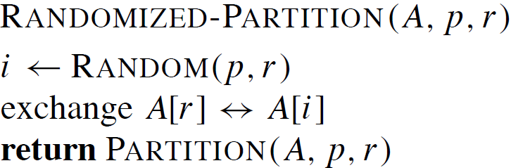
Randomized version of quicksort
We have assumed that all input permutations are equally likely.
This is not always true.
To correct this, we add randomization to quicksort.
Algorithm Analysis
L3.<number>

Slide 34
Average Case (Detailed)
The dominant cost of the algorithm is partitioning.
PARTITION removes the pivot element from future consideration each time. Thus, PARTITION is called at most n times.
The amount of work that each call to PARTITION does is a constant plus the number of comparisons that are performed in its for loop.
Let X = the total number of comparisons performed in all calls to PARTITION. So, total work done over the entire execution is O(n + X)..
Algorithm Analysis
L3.<number>

Slide 35
Average Case – Number of Comparisons
For ease of analysis:
Rename the elements of A as z₁, z₂, . . . , z_{n}, with z_{i} being the i th smallest element.
Define the set Z_{i j} = {z_{i} , z_{i+1}, . . . , z_{j} } to be the set of elements between z_{i} and z_{j} , inclusive.
Algorithm Analysis
L3.<number>

Slide 36
Average Case – Number of Comparisons (cont.)
Important:
Each pair of elements is compared at most once, because elements are compared only to the pivot element, and then the pivot element is never in any later call to PARTITION.
Let X_{ij} = I {z_{i} is compared to z_{j} }.
Algorithm Analysis
L3.<number>

Slide 37
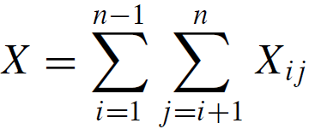
Average Case – Number of Comparisons (cont.)
Since each pair is compared at most once, the total number of comparisons performed by the algorithm is
Algorithm Analysis
L3.<number>

Slide 38
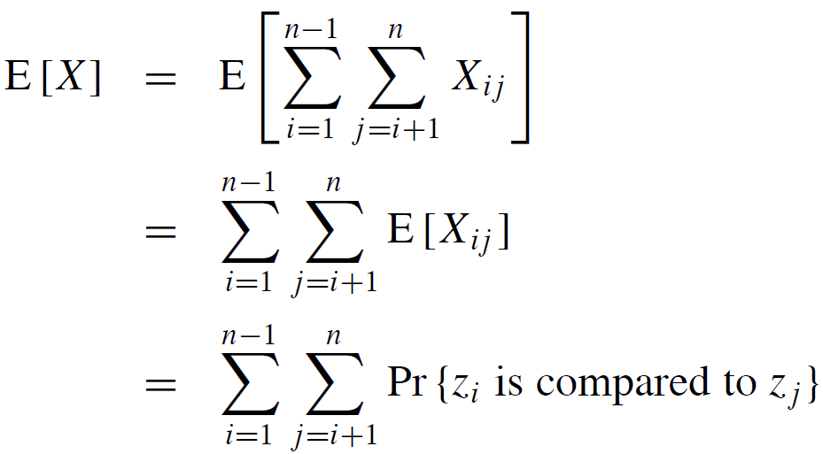
Average Case – Number of Comparisons (cont.)
Expectations of both sides:
Algorithm Analysis
L3.<number>

Slide 39
Average Case – Number of Comparisons (cont.)
Probability that two elements are compared:
Once a pivot x is chosen such that z_{i} < x < z_{j} , then z_{i} and z_{j} will never be compared at any later time.
If either z_{i} or z_{j} is chosen before any other element of Z_{ij} , then it will be compared to all the elements of Z_{ij}, except itself.
The probability that z_{i} is compared to z_{j} is the probability that either z_{i} or z_{j} is the first element chosen
Algorithm Analysis
L3.<number>

Slide 40
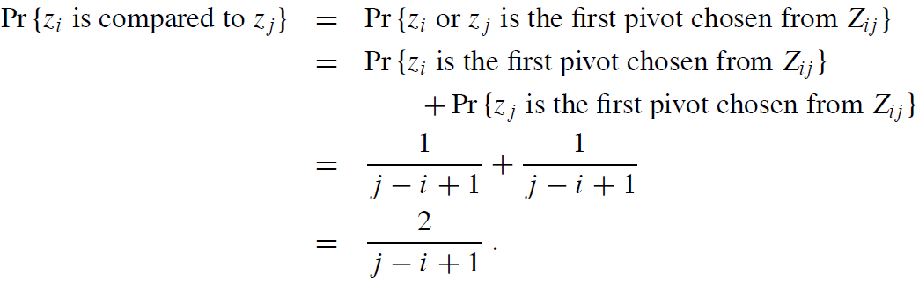
Average Case – Number of Comparisons (cont.)
There are j−i+1 elements, and pivots are chosen randomly and independently.
Thus, the probability that any particular one of them is the first one chosen is 1/( j − i + 1).
Algorithm Analysis
L3.<number>

Slide 41
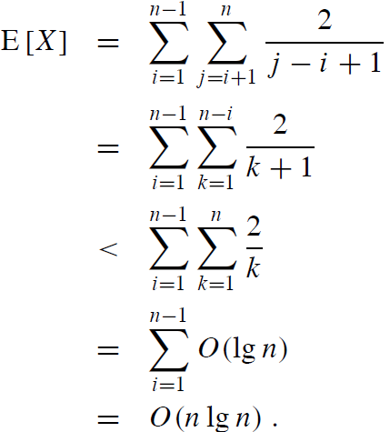
Average Case – Number of Comparisons (cont.)
simple transformation
approximation
Harmonic series
Algorithm Analysis
L3.<number>

